Slide 1
Deep Learning: 101
Neural Networks - Perceptron

Slide 2
Why Neural Networks?
Neural networks, also conventionally known as connectionist models, are inspired by the human brain.
Like the human brain, neural networks are a collection of a large number of artificial neurons connected to each other via synaptic strengths called weights.
Just as we learn through examples provided to us by our elders, artificial neural networks learn by examples presented to them as training datasets.

Slide 3
Deep Learning Timeline
1943: McCulloch Pitts proposed MCP model
The model could perform logical operations like AND/OR/NOT
The MCP model had fixed weights and biases; there was no learning possible
1958: Frank Rosenblatt proposed Perceptron
1970s-1980s: AI Winter
1998: Yann LeCunn introduces LeNet, working on MNIST dataset
.
.
.
.
.
2012: AlexNet: ConvNet with GPU

Slide 4
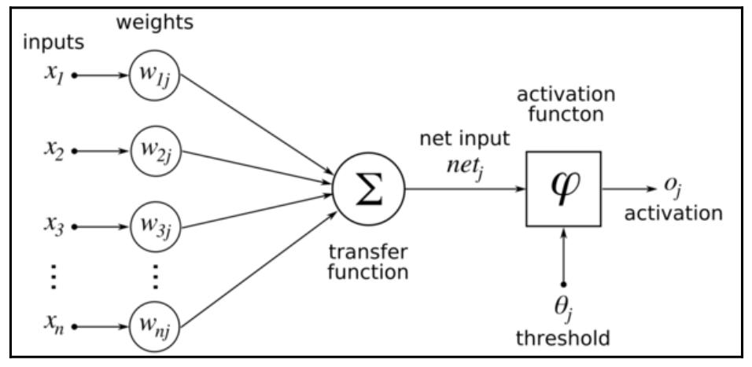
How does a Perceptron look like?
It consists of two major components:
an adder that (weighted) sums all the inputs to this neuron, and a processing unit that takes the weighted sum and generates an output based on a predefined function, called activation function. Each artificial neuron has its own set of weights and thresholds (biases); it learns these weights and thresholds through different learning algorithms

Slide 5
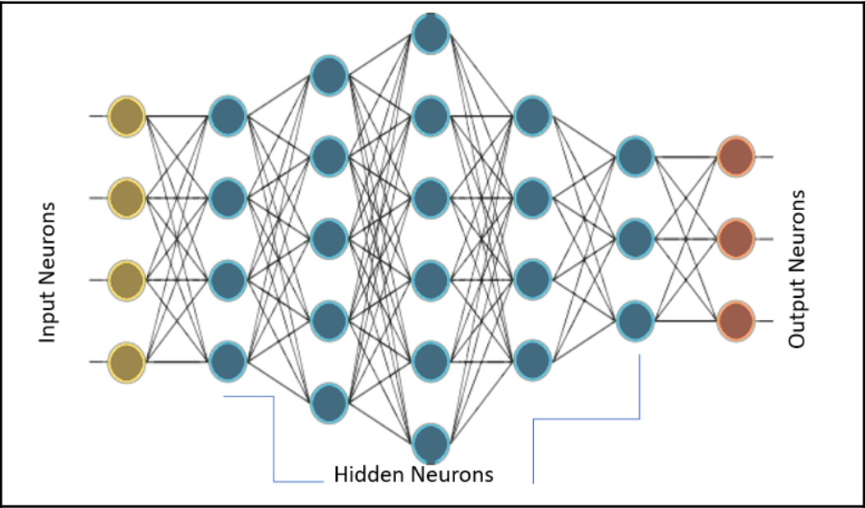
Multi-layered Perceptron (MLP)
Notes:
0th layer
Final Layer
Fully Conneted Layer
Hidden Layer

Slide 6
Now let’s look into some of the implementation of Logical Gates with MLP

Slide 7
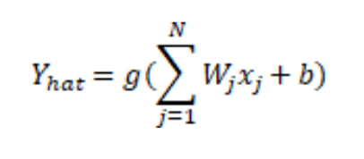
Activation Function
Every neuron must have an activation function. They are what gives the neuron the nonlinear property necessary to model the complex nonlinear datasets.
The function takes the weighted sum of all the inputs and generates an output signal. You can think of it as a transform between input and output. Using the proper activation function, we can bound our output values in a defined range.
g represents the activation function.
The argument to the activation function (∑W_{j}x_{j} +b) is called activity of the neuron.

Slide 8
Types of Activation Function:
Threshold Activation Function
Sigmoidal Activation Function
Hyperbolic Tangent Activation Function
Linear Activation Function
Rectified Linear Units (ReLU)
Softmax Activation Function

Slide 9
Threshold activation function was used by McCulloch Pitts Neuron and initial Perceptrons. It is not differentiable and is discontinuous at x=0. Therefore, it is not possible to use this activation function to train using gradient descent or its variants.
Sigmoid activation function was very popular at one time. If you look at the curve, it looks like a continuous version of the threshold activation function. It suffers from the vanishing gradient problem, that is, the gradient of the function becomes zero near the two edges. This makes training and optimization difficult.
Hyperbolic Tangent activation function is again sigmoidal in shape and has nonlinear properties. The function is centered at zero and has steeper derivatives compared to sigmoid. Like sigmoid, this also suffers from the vanishing gradient problem.

Slide 10
Linear activation function is, as the name suggests, linear in nature. The function is unbounded from both sides [-inf, inf]. Its linearity is its major problem. The sum of linear functions will be a linear function and the linear function of a linear function too is a linear function. Thus, using this function, one cannot grasp the non-linearities present in complex datasets.
ReLU activation function is the rectified version of the linear activation function, and this rectification allows it to capture non-linearities when used in multiple layers. One of the major advantages of using ReLU is that it leads to sparse activation; at any instant, all the neurons with negative activity are not firing. This makes the network lighter in terms of computation. ReLU neurons suffer from the dying ReLU problem, that is, neurons that do not fire will have their gradients zero and, hence, will not be able to undergo any training and stay off (dead). Despite this problem, ReLU today is one of the most used activation functions for hidden layers.

Slide 11
Softmax activation function is popularly used as the activation function of the output layer. The function is bounded in the range [0,1]. It is used to represent the probability of a class in a multiclass classification problem. The sum of the output of all the units will always be 1.

Slide 12
Let’s look into some mathematics!

Slide 13
Cost function (of Logistic Regression):
Loss (error) function = L(y’,y) = ½ (y’-y)² [generally not done since optimization becomes non-convex]
Actual Loss function = L(y’,y) = -(y log y’ + (1-y)log(1-y’))
Cost function J(w,b) = 1/m Σ^{m}_{i=1}L(y’,y)
Gradient Descent: Repeat{ w:= w - ɑ.δJ(w,b)/δb
}

Slide 14
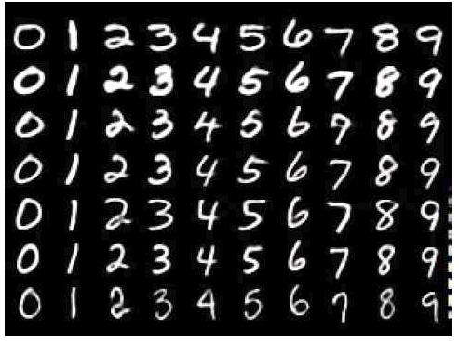
Let’s try to code!
MNIST Dataset:
The MNIST database of handwritten digits, available from this page, has a training set of 60,000 examples, and a test set of 10,000 examples. It is a subset of a larger set available from NIST. The digits have been size-normalized and centered in a fixed-size image.
It is a good database for people who want to try learning techniques and pattern recognition methods on real-world data while spending minimal efforts on preprocessing and formatting.

Slide 15
Assignment
Predict the housing prices using MLP.
Use Boston House Prices Dataset( available in sklearn)
To be done by Monday(3/9/18)

Slide 16
“I think we should think of AI as the intellectual equivalent of a backhoe. It will be much better than us at a lot of things.”
- Geoffrey Hinton, University of Toronto

Slide 17

Thanks!
IEEE CS DTU
Delhi Technological University
Join IEEE CS DTU:
Samarth: 95821 84794
Vibhor: 98106 60617
Riddhima: 98997 87404
Drishti: 70421 43288
Umang: 72908 44519

